Slide 1


TaskUp
Your Project Management Solution!

Slide 2


Problem
How did we get here?
1.
The team always had issues when they were working on a feature. They could not tell when the feature was done.
A member of the group, once recorded struggles in his freelance projects while working with a team of developers..
2.

Slide 3



Solution type
Software solution.
Utopia
Reason for solution
What we seek to do.
Team members can effectively collaborate and work on projects.
What will the solution offer
The solution will allow project managers to delegate tasks amongst contributors of a project.

Slide 4



Our
Product
Let’s show you the world you’ve always dreamt of.

Slide 5
Features
1.
A responsive web application
What our solution has to offer.
2.
Feature to enable project managers create projects.
3.
Addition of tasks by project managers and contributors.
4.
Report system that summarizes activities of contributors of a project.

Slide 6


Product implementation

Slide 7
Software
Development Process
Our software was developed based on the agile methodology coupled with inspirations from the waterfall model.

Slide 8
Architecture and Stack
How did we build this?

Slide 9
The solution is intended to be a decoupled web app. This will have a backend implemented in the REST architecture.
Flask, a python web framework was chosen for our backend implementation.
Vuejs, a javascript framework was chosen for the implementation of our frontend.
The front end will consume this data from the REST backend.

Slide 10
Target
Market
1.
Freelance Developers.
2.
Project Managers.
3.
Designers and artisans.

Slide 11


Chat feature attached to various tasks for structured and ease of communication.
Future Roadmap
Report system that summarizes activities of contributors of a project and the project at large
What we intend to do going forward.
Alert system for tasks and projects to tell contributors and managers when deadlines are approaching

Slide 12
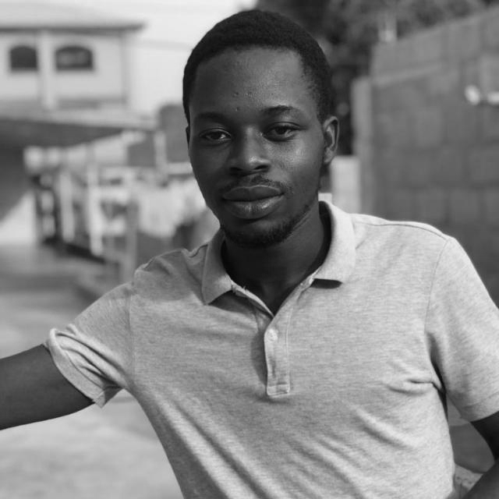
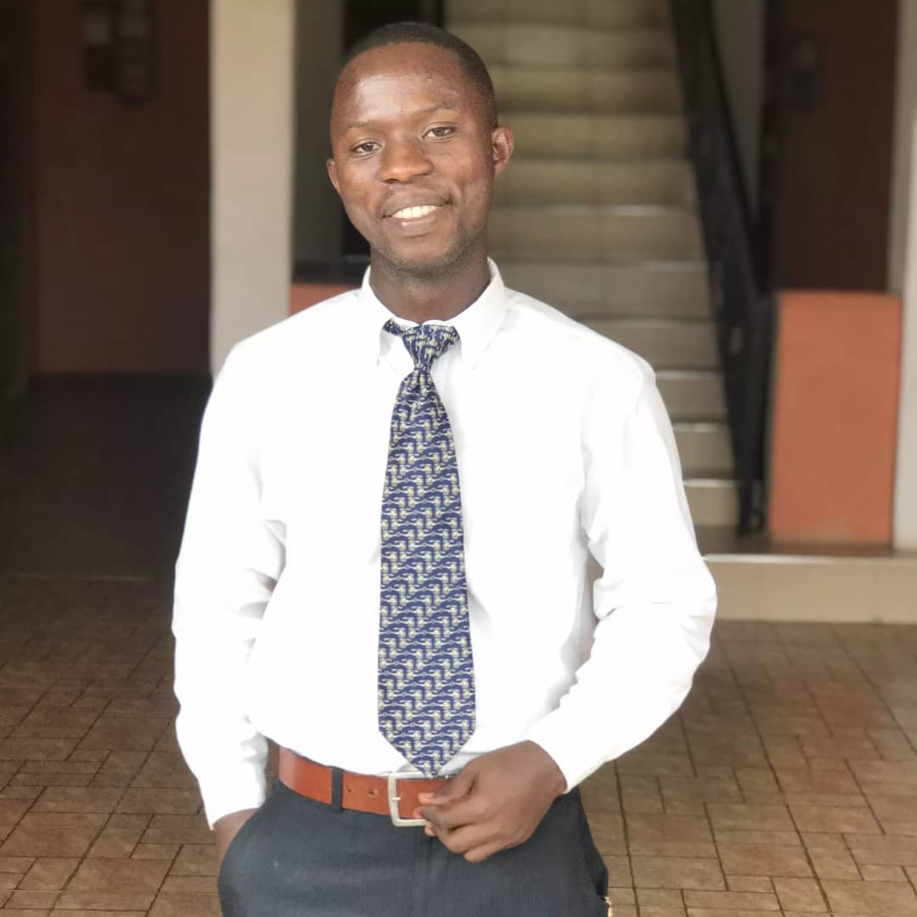
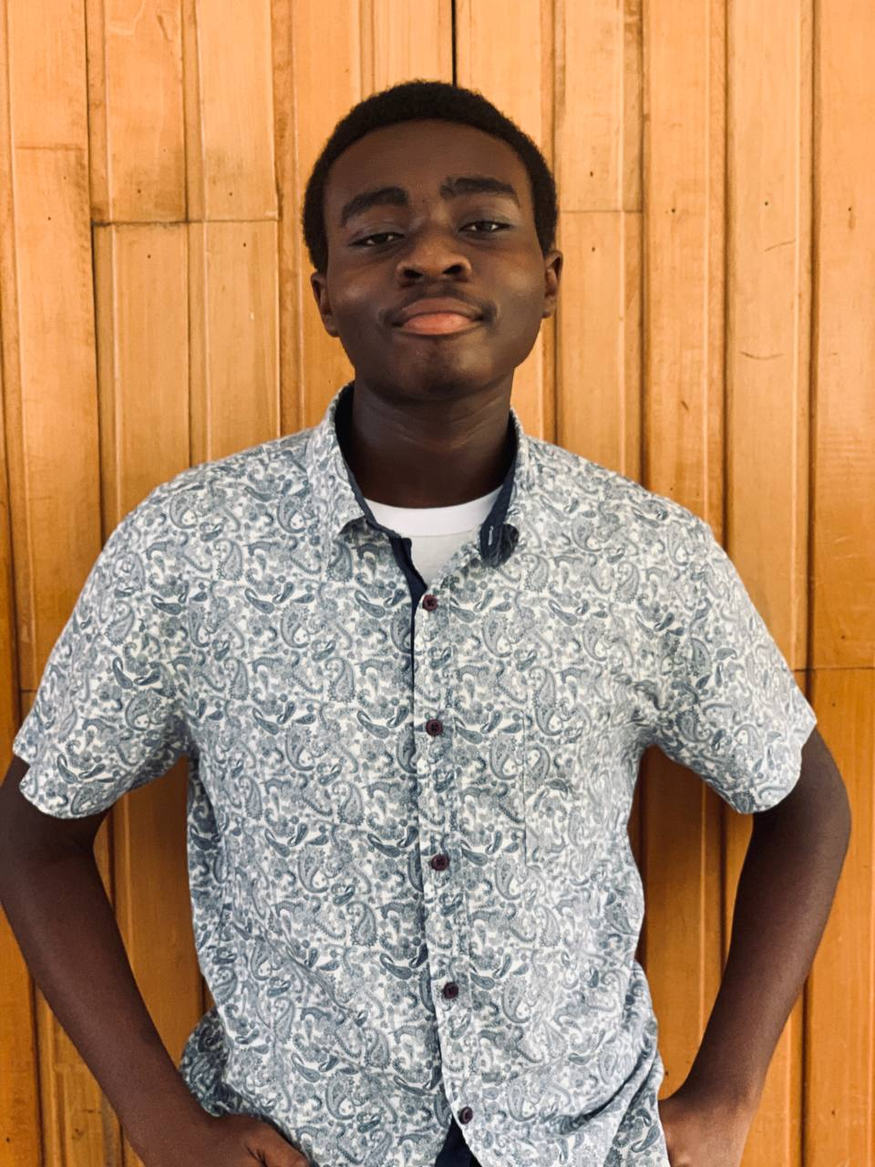
Meet our Team
Joseph Oti Boateng
Elton Gyabeng
Nana Kwame A. Nyarko
Project Manager
Back End Member
Full Stack Dev

Slide 13
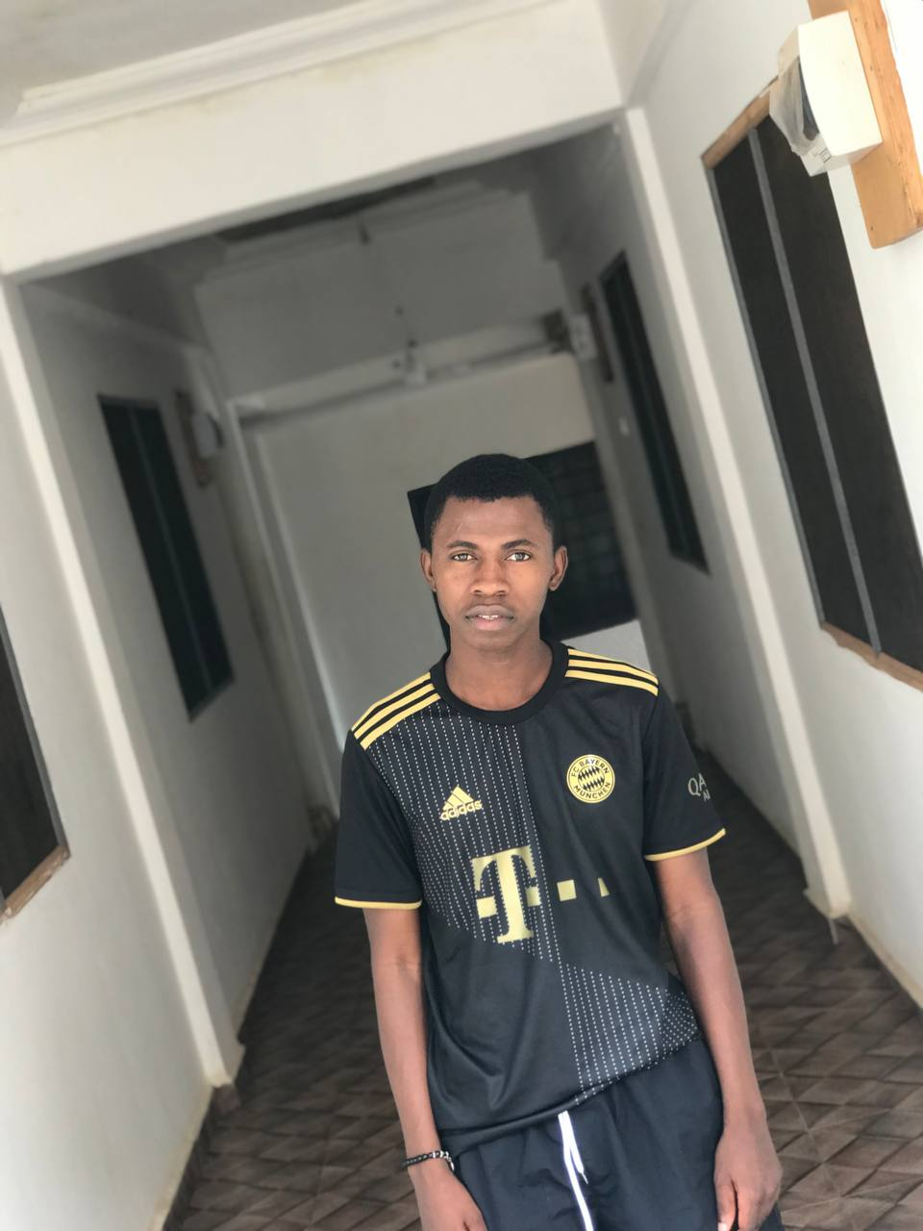
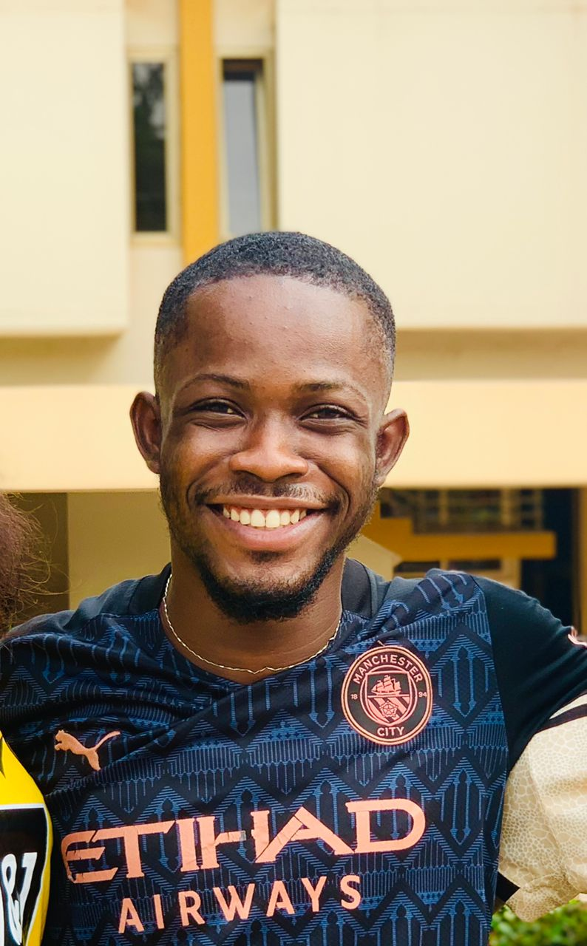
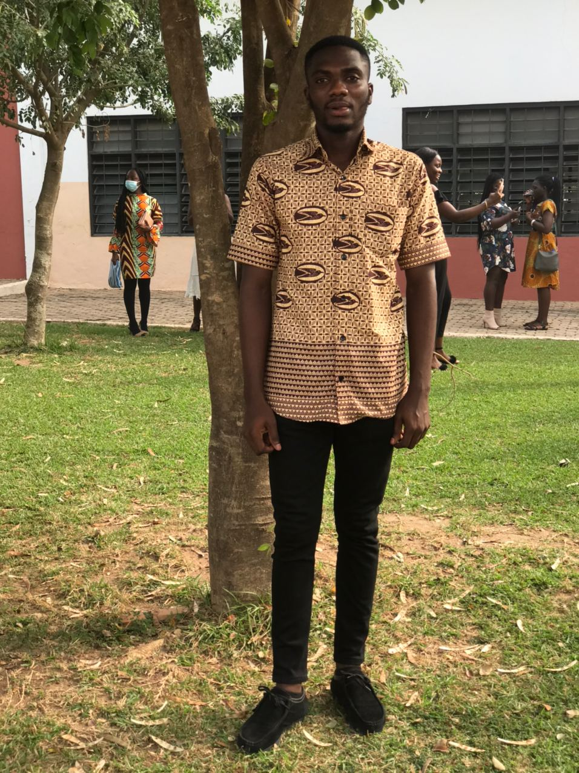
Meet our Team
Asiedu Amos
Agyeman Francis
Theophilus Asante
Back End Member
Front End Leader
Front End Member

Slide 14
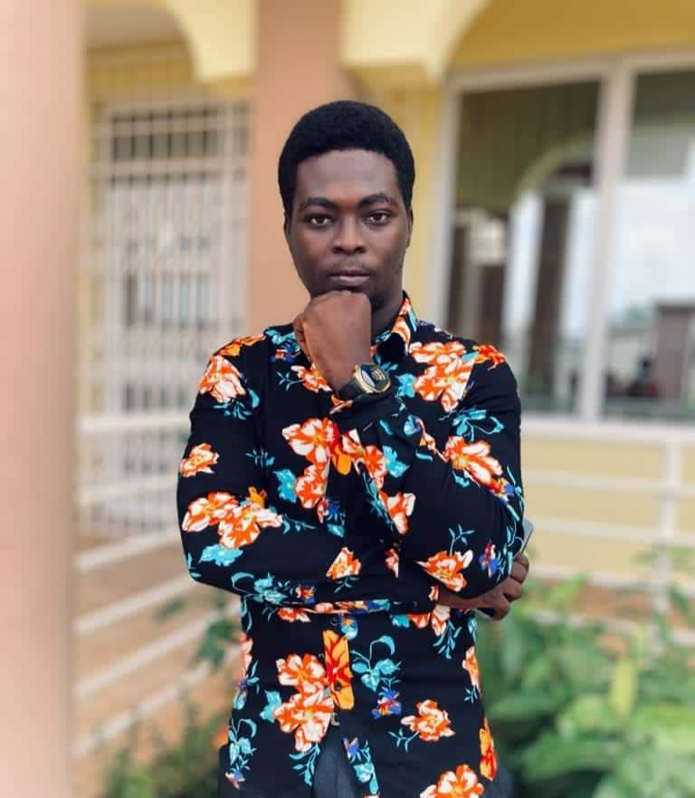
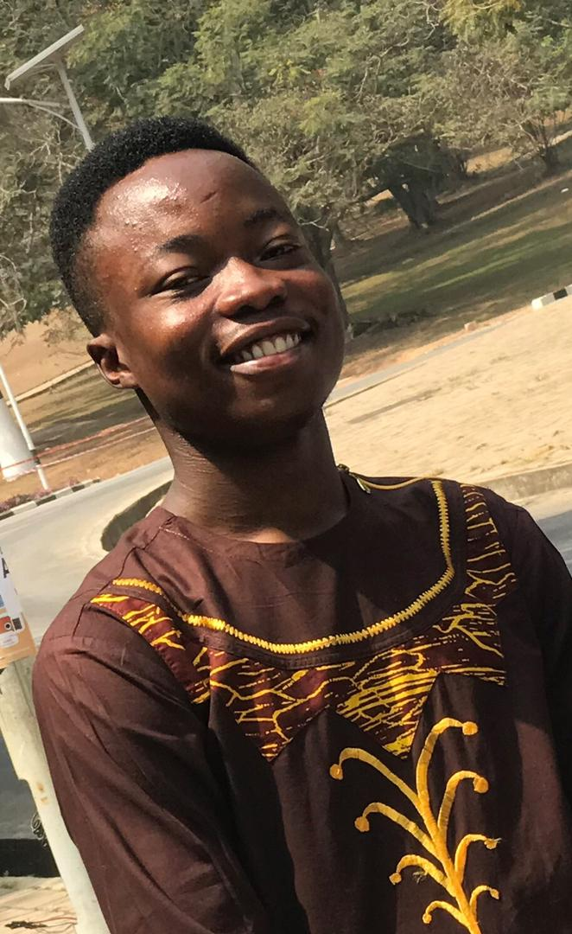
Meet our Team
Bright
John Kpamsogah
Front End Member
Front End Member

Slide 15
Thank You.

Slide 16

















Resource
Page
Use these icons and illustrations in your
Canva Presentation.
Happy designing!

